Slide 1
Lecture 03 Distributions and patterns
Module INM433 – Visual Analytics
given by
prof. Gennady Andrienko and
prof. Natalia Andrienko

Slide 2
Previous lecture
Data types, structures, formats
References and attributes; attribute values as functions of references
Analytical tasks
General task: study the behaviour of the function references → attribute values
Specialized formulations for different types of references, e.g., study distribution / variation over time, over space, over set of objects
Coping with multiple attributes
Dimension-reduction (projection)
Partition-based clustering

Slide 3
This lecture
Analysis as a multi-step process (by example); importance of human reasoning and understanding
Notion of a distribution; kinds of distribution
Patterns in distributions; importance of seeing patterns for gaining understanding
Spatialization (projection) as a tool for exploring distributions
Dimension-reduction
Projection based on pairwise distances

Slide 4
Example of analysis process
VAST Challenge 2011

Slide 5
Problem statement
An epidemic outbreak in a city called Vastopolis
Data: geolocated tweets (include message, time, and coordinates)
Some tweets mention disease symptoms: flu, chills, fever, …
Questions:
When and where did the outbreak start?
How did it develop?
What is the disease transmission mechanism?
What is the likely further development?

Slide 6
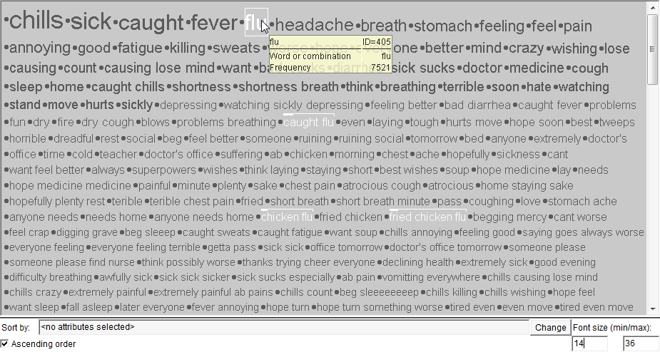
Using a database query, we selected the tweets mentioning disease symptoms from the whole set of tweets. The word cloud display below shows the most frequent words and word combinations from the selected tweets. The font sizes are proportional to the frequencies.
It appears that not all tweets really refer to bad health condition.

Slide 7
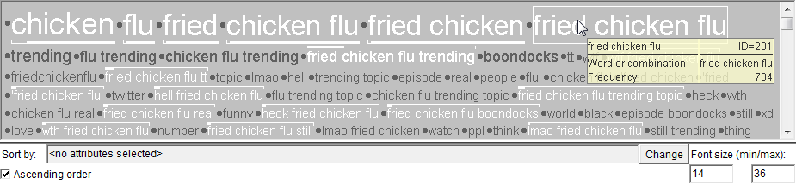
Frequent words from the subset of tweets containing keywords ‘chicken’ and ‘flu’
We remove these tweets from the selected set and apply the further analysis to the remaining tweets.

Slide 8
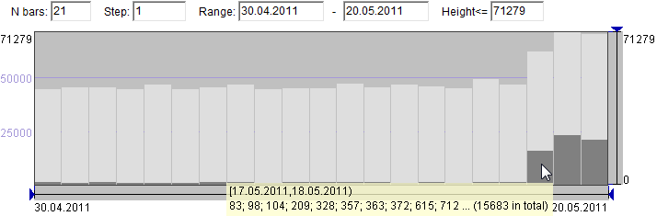
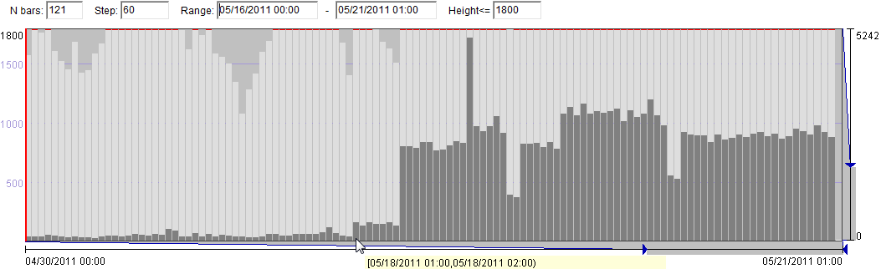
Temporal distribution of the disease-related tweets
Daily resolution
Hourly resolution, last 5 days
Outbreak start time

Slide 9
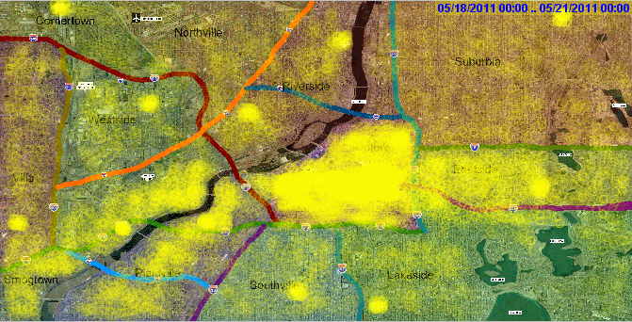
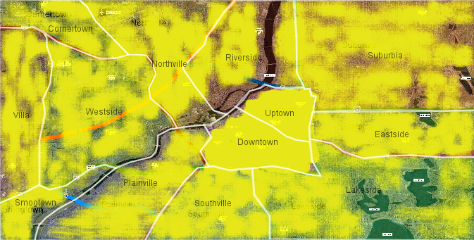
Spatial distribution of the disease-related tweets
The tweets are represented by yellow circles with very high transparency (95%).
Spatial distribution of all tweets

Slide 10
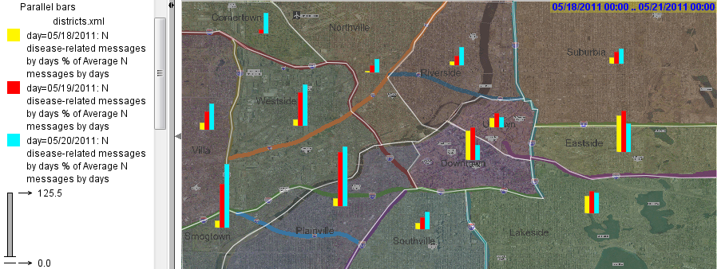
Spatial distribution of the disease-related tweets
The bar diagrams within the district boundaries show the ratios of the numbers of the disease-related messages in the three days of the epidemics to the average daily numbers of all messages posted in the districts.
affected on May 19-20
affected on May 18

Slide 11
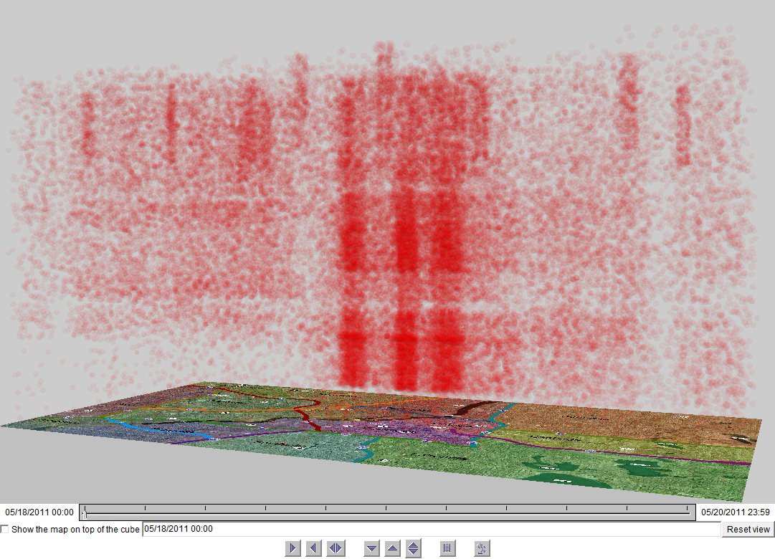
Spatio-temporal distribution
time

Slide 12
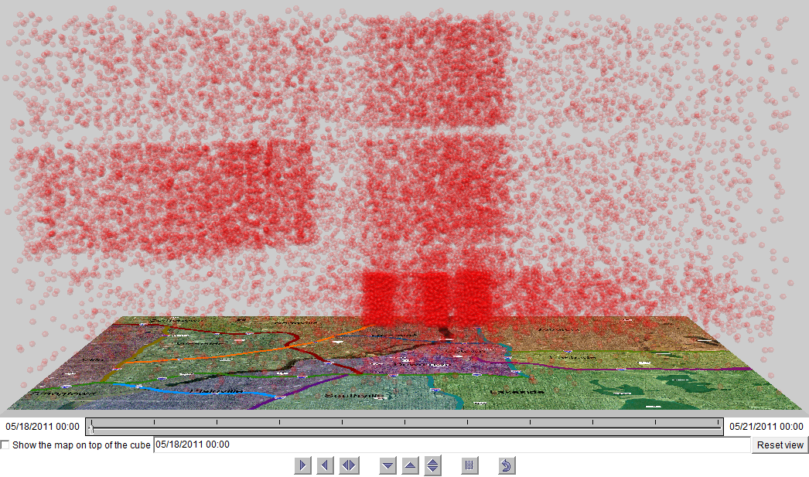
Spatio-temporal distribution of the primary outbreak-related tweets (one tweet per person)
May 20
May 19
time
May 18
These clusters appeared on different days. How do they differ regarding the disease?

Slide 13
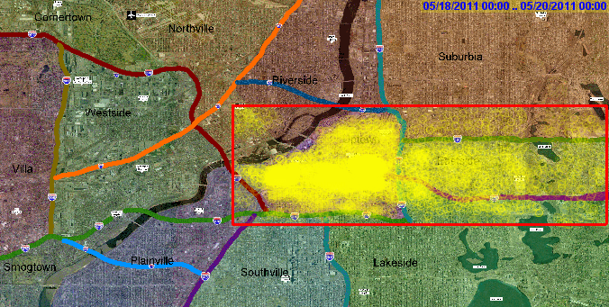
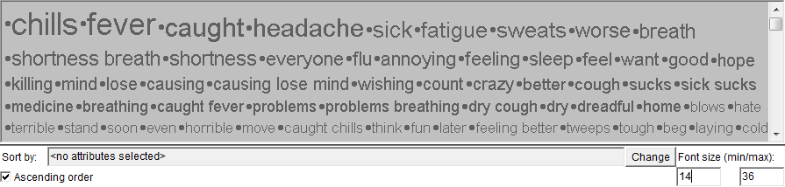
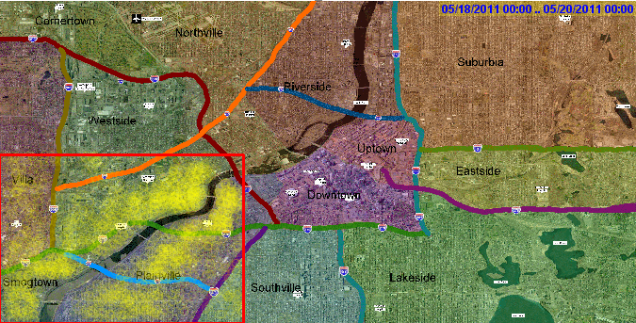
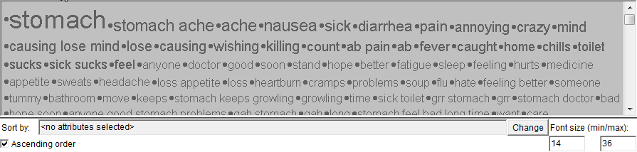
Comparing texts from two spatial clusters
wind
The keywords indicate two distinct diseases
river

Slide 14
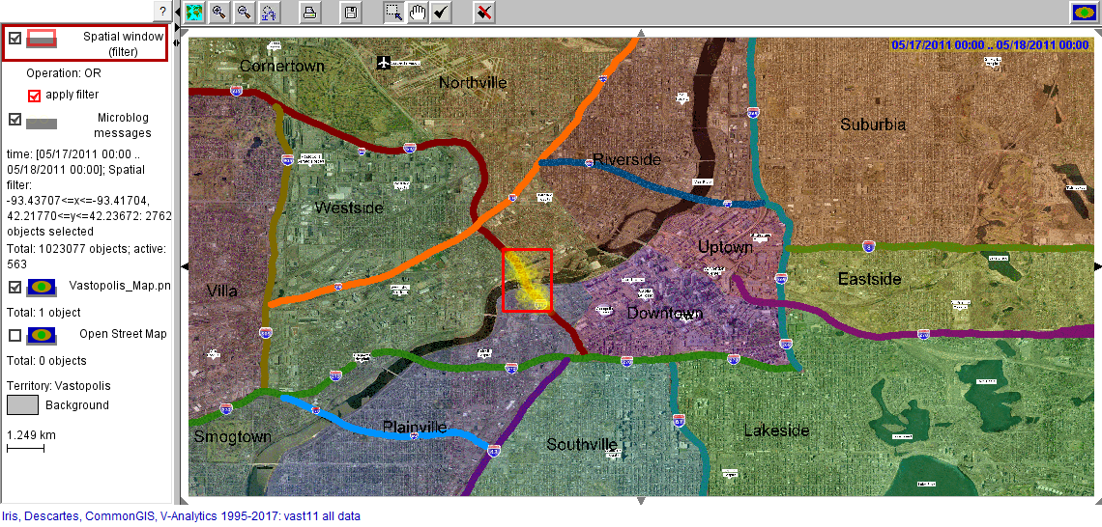
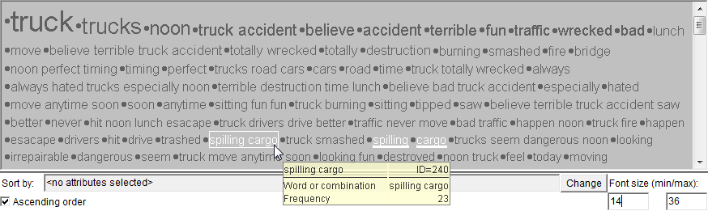
What can be the reason?
The spatio-temporal distribution patterns suggest that both diseases may originate from the area around the motorway bridge. Something might have happen there before May 18, when the outbreak started.
truck fire → smoke → wind → respiratory disorders
spilling cargo → water contamination → digestive disorders
The frequent words and combinations from the tweets posted near the motorway bridge on May 17.

Slide 15
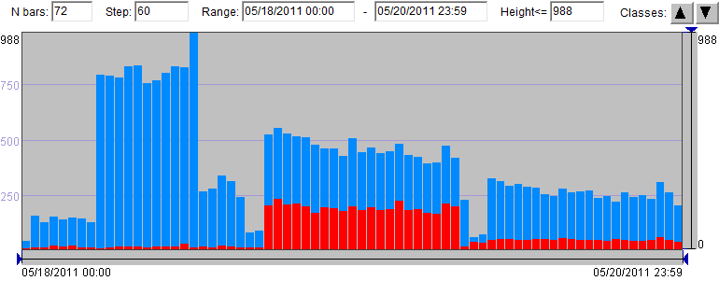
Outbreak development trend
The time histogram of the frequencies of the first mentioning of the disease symptoms. The red bar segments correspond to the messages mentioning digestive disorders and the blue segments to the remaining messages.

Slide 16
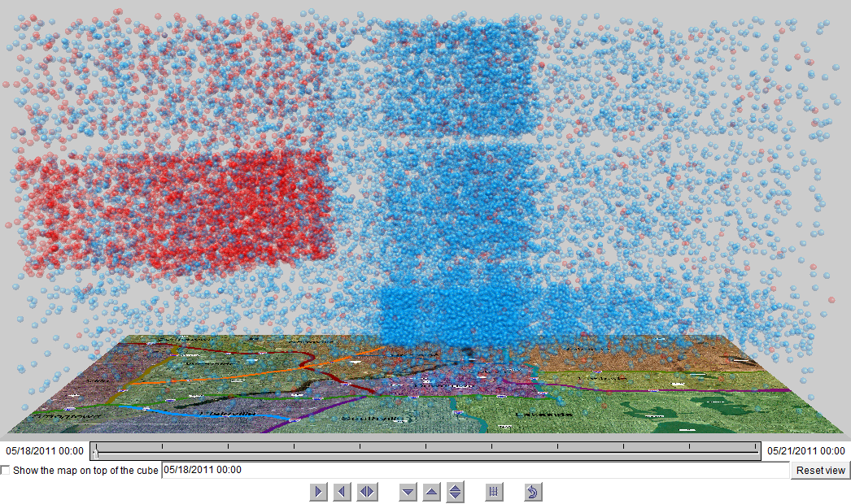
Is the outbreak contained?
The spatio-temporal distribution of the tweets mentioning health problems for the first time. The tweets mentioning digestive disorders are represented in red and the remaining tweets in blue.

Slide 17
Summary: the course of events reconstructed
May 17, around noon: a traffic accident on the motorway bridge in the city centre caused a fire on a truck carrying a toxic substance.
The western wind moved the smoke containing toxic particles to the central and eastern areas of the city. The cargo from the damaged car spilled into the river and was moved by the river flow towards the southwest.
May 18: Many people in the city centre and on the east inhaled toxic particles and got ill, with symptoms similar to flu.
May 19: People who were on the river banks and might have direct contacts with the water got stomach disorders due to the toxic spill into the river.
May 20: The number of people getting stomach disorders notably decreased.
May 19-20: New cases of people feeling flu-like symptoms continued to appear, calling for some measures to clean the territory.

Slide 18
Steps and subtasks in our analysis process
Data preparation: selection of the subset of potentially relevant records.
Analysis of the temporal distribution of the records.
Analysis of the spatial distribution of the tweets.
Verification of observed spatio-temporal patterns.
Analysis and comparison of the frequency distributions of the keywords in two subsets of the messages.
Reasoning about the disease transmission mechanisms by relating the observed patterns to context information (wind, river flow).
Hypothesizing and searching for a common reason of two diseases based on observed spatio-temporal patterns.
In each step, we used visual aids for our thinking.

Slide 19
General conclusions
Human reasoning is essential for solving non-trivial problems.
By reasoning, humans extract meaningful information from data and construct new knowledge.
Visual representations facilitate human reasoning by effectively conveying information to the human mind.
Human analysts often perform analysis by considering various distributions and identifying patterns.
Distributions considered in our example: temporal, spatial, spatio-temporal
Patterns identified in our example: temporal trends, spatial clusters, spatio-temporal clusters, spatio-temporal trends
Patterns need to be interpreted, verified, and linked into the “big picture”* (possibly, including some background knowledge)
* the entire perspective on a situation or issue (Merriam-Webster dictionary)

Slide 20
Conceptual background
General goal of analysis
Visual analytics activity and its relation to data science
Relationships, distributions, patterns

Slide 21
Subject of analysis
Analysis is always focused on a certain subject, which is a thing or phenomenon that needs to be understood and, possibly, modelled.
A non-trivial subject can be seen as a system composed of multiple components linked by relationships. Understanding a subject requires understanding the relationships between its components.
Subject of the VAST Challenge: epidemic outbreak
Components and relationships:
Disease-affected sub-population
change over
Time
distributed in
have
part of
Population
occurs in
distributed in
Disease
consists of
can have, can transmit
move in
Persons
can generate
distributed in
can refer to
Space
Tweets
Words
can transmit
changes over
distributed in
contain
moves in
River
can transmit
Wind
moves in

Slide 22
General goal of analysis
Analysis is applied not directly to the subject but to data, which are recorded observations and measurements.
VAST Challenge subject: epidemic outbreak
VAST Challenge data: geolocated microblog messages
Data specify correspondences between particular elements of different components and thereby partly reflect the relationships between the components.
Correspondences in VAST Challenge data: microblog users – disease symptoms (words in texts) – time moments – spatial locations; rivers, bridges, etc. – spatial locations; weather conditions – time intervals
The required outcome of the analysis is understanding (= knowledge) of the subject generated in the mind of the analysts, plus, possibly a computer model of the subject.

Slide 23
Visual analytics activity
It is not making pictures but using pictures to think and understand.
Real world
Computer
Human
Visualization
Interaction
Cognition
Subject (of analysis)
Component
Visual mapping
Visual mapping
Data
Perception
☺
Knowledge
Relationships
Understanding of the subject
Component
…
Transformation
Component
Computational processing
Refinement
Controlling
Analysis
Computed artefacts
represents

Slide 24
Data science process and visual analytics
The data science process involves three different subjects:
State problem
Pose questions
Generate initial hypotheses
Subject: data
Prepare data to analysis
Subject: phenomenon
Subject: model
Solve problem
Answer questions
Confirm or refute hypotheses
Understand data properties
Explore data
Build model
Evaluate model
Get data
Visual analytics approaches can be applied to each subject.
Understand data: structure, amount, coverage, precision, errors, missing measurements, noise, … ⇒ suitability for analysis, required transformations, applicability of techniques, …
Understand phenomenon: behaviour, reasons, driving forces, …
Understand model: accuracy, applicability scope and conditions, assumptions, limitations, parameters, …
Data under analysis: correspondences between inputs, parameter settings, and outputs

Slide 25
Understanding involves abstraction
Goal of analysis: understand subject = understand relationships between its components
Components are (usually) sets: people, messages, words, space (set of locations), time (set of moments), …
⇒ Goal: understand relationships between sets as wholes
Data specify correspondences between particular elements
Understanding requires abstraction from elements to sets and from particular correspondences to overall relationships
Abstraction = “seeing the forest for the trees”

Slide 26
Abstraction via finding patterns in distributions
Relationships between two sets can often be understood by examining the distribution of the elements of one of them over the elements of the other.
A distribution is composed of the correspondences between set elements specified in the data.
Examples: distributions of the tweets over time and over space, distribution of keywords over the tweets, …
A distribution represents a function from references to attributes whose behaviour needs to be studied (recall the previous lecture)
Pattern: multiple correspondences that can be described together as a meaningful whole, without listing these correspondences
Abstraction!
Outlier: an item that cannot be joined together with other items because it is too different from all others.

Slide 27
Analysis: searching for patterns and detecting outliers
Analysis involves identifying patterns in relationships between sets.
Uncovered patterns need to be interpreted (what do they mean?), verified (are they true?), and, possibly, explained (why do they exist?).
In visual representations, patterns are often manifested as particular shapes.
Outliers are often manifested as isolated visual marks (such as dots) that are not integrated in any shape formed by other marks.
The analyst needs to understand whether outliers are errors in data, or they represent exceptional but real cases.
Removing outliers may facilitate seeing patterns, and it may be necessary for building models.

Slide 28
Types of distributions and patterns

Slide 29
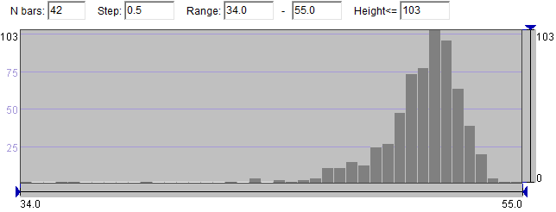
Frequency distribution
Example: the frequency distribution of the keywords from the tweets posted in the centre and on the east characterises the disease that appeared there.
Example: the frequency distribution of values of a numeric attribute (% of female population in the wards of London) is represented visually by a frequency histogram.
general shape
outliers

Slide 30
Temporal distribution
Inherent properties of time: ordering and distance relationships between the elements.
Time may also have cyclic structure
Cycles: daily, weekly, annual, domain-specific, e.g., in climat, astronomy, manufacturing, economy.
⇒ There are ordering and distance relationships between the elements based on their positions in the cycles.
Patterns in temporal distributions emerge due to these inherent properties of time.
A pattern represents the manner in which a time-distributed aspect changes during a time interval.
Change: for a set distributed over time, the difference between the elements referring to consecutive time moments.

Slide 31
Types of patterns in temporal distributions
Constancy: Absence of (sufficiently large) changes during a time interval.
Trend: Increase or decrease, or, more generally, same kind of change continued during a time interval.
Jump : abrupt or fast increase. Drop: abrupt or fast decrease.
Peak: increase followed by decrease. Trough: decrease followed by increase.
Fluctuation: Many small opposite changes alternating along an interval.
Temporal regularity: Repeated appearances of the same or similar entities, values, or patterns at (approximately) equal distances in time.
Periodicity: Repeated appearances of the same or similar entities, values, changes, or patterns at (approximately) the same positions in different temporal cycles.

Slide 32
Examples of temporal patterns
Epidemic outbreak development
peak
decreasing trend
jump
trough
trough
decreasing trend
jump (red)
constancy
constancy (red)

Slide 33
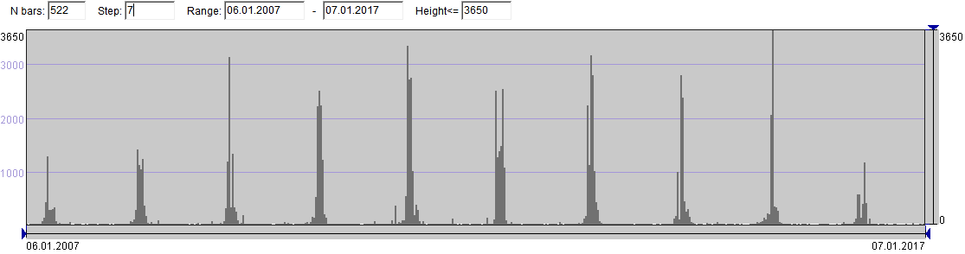
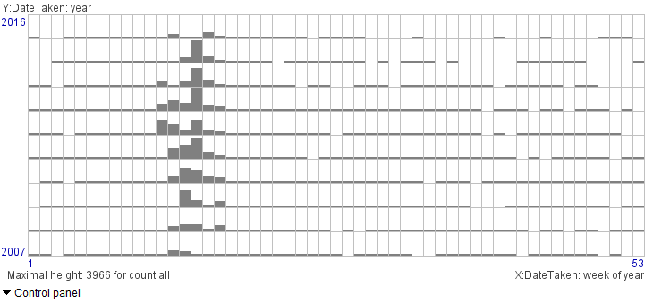
An example of a periodic pattern
Photos of cherry blossoming published in flickr
2d time histogram
Rows: years
Columns: weeks
Bar sizes: counts of taken photos

Slide 34
Spatial distribution
Inherent property of space: distance relationships between elements (i.e., locations).
Spatial patterns emerge mostly due to the existence of distances.
There are no inherent ordering relationships. However, it is often possible to define meaningful spatial directions, e.g., south-to-north, east-to-west, centre-to-periphery
In geographic space, also directions along linear geographic objects, such as rivers, coastlines, roads, etc.
A chosen spatial direction introduces partial ordering relationships between locations (i.e., ordering exists only for some location pairs).
Distributions along spatial directions may involve ordering-based pattern types similar to those in temporal distributions.
In particular, spatial trend = same kind of change along a spatial direction.

Slide 35
Patterns in spatial distributions of discrete entities
Spatial density patterns:
dense or sparse: small or large distances between entities, many or few entities per area or volume unit
spatial cluster: many entities densely packed within a small area
scattering: few entities spread over a large area
concentration: dense distribution near some location and decreasing density as the distance from this location increases
trend of density change along some spatial direction
Spatial shapes formed by relative arrangement of multiple entities, e.g., alignments
Patterns in the geographic space are often related to the properties of the underlying space and the objects existing in it.

Slide 36
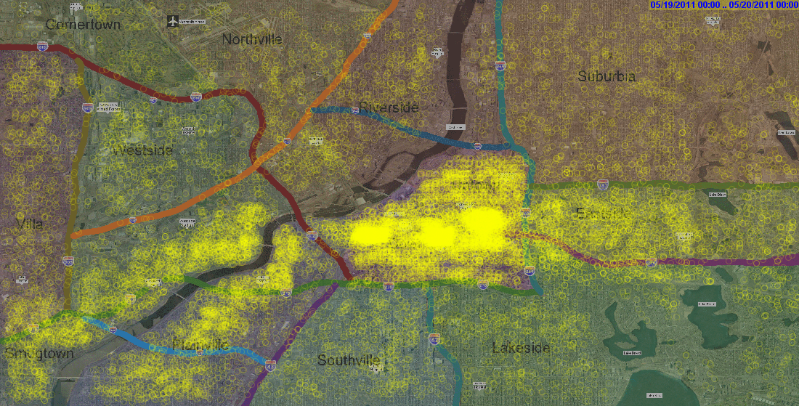
Examples of spatial patterns of entity distribution
Spatial distribution of outbreak-related tweets on May 19 (2nd day of the outbreak)
low density
low density
cluster
density trend (decrease)
dense
alignment
concentrations
alignment
sparse

Slide 37
Patterns in spatial distributions of attribute values
Main question in studying spatial distributions: how close or similar are attribute values at close locations.
Change in space: difference between attribute values at neighbouring (i.e., spatially close) locations.
Smooth distribution: gradual changes along any direction (small differences between neighbouring locations)
Rough distribution: presence of abrupt changes.
Cluster: close or similar values at multiple neighbouring locations.
Spatial outlier: value at some location differs much from values around.
Hot or cold spot: values in a small area are higher or lower than around.
Spatial trend: same kind of value change along some spatial direction.
Alignment of close or similar values.

Slide 38
Examples of spatial patterns of attribute values distribution
cluster of high values
hot spot
cold spot
trend (increase)
cold spot
alignment of low values
alignment of high values
cluster of high values

Slide 39
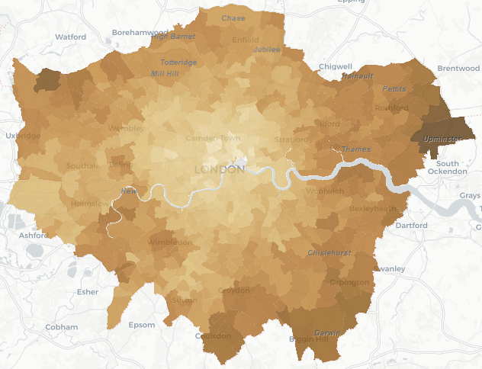
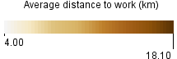
An example of a spatial trend: centre to periphery

Slide 40
Joint distribution (co-distribution) of elements of two sets over a third set
For example, co-distribution of values of numeric attributes.
Types of patterns:
Frequency: frequent combinations, rare or never occurring combinations
Correlation (interrelation): tendency to co-occurrence, e.g., fever and headache

Slide 41
Spatial patterns in scatterplots
When we use scatterplots for analysing joint distributions, we, in fact, look for spatial patterns in the distribution of the dots over the plot area.
Spatial clusters correspond to frequent co-occurrences of values from some intervals.
Alignments indicate correlations.
Other meaningful patterns: high density, sparsity, concentration, scattering
Outliers are well visible.

Slide 42
The idea of scatterplot can be extended to more complex objects (e.g., time series)
https://www.nytimes.com/interactive/2014/06/05/upshot/how-the-recession-reshaped-the-economy-in-255-charts.html

Slide 44
How to generalise the approach further?
The display space provides convenient opportunities for observing spatial distributions and identifying spatial patterns.
Humans have an innate capability to perceive multiple things located closely as being united in a larger shape or structure, i.e., as a pattern.
The display space may represent not only a real space (e.g., geographic) but also an artificial space.
If the distances in an artificial space are meaningful, then also spatial patterns emerging in this space are meaningful and can be interpreted.
In a scatterplot, distances represent differences between attribute values.
Construction principle: plot dimensions represent numeric attributes.
Generalisation: use any other construction principle such that the distances represent differences, or dissimilarities, between objects positioned within the space.

Slide 45
Spatialization: creation and use of artificial spaces

Slide 46
Spatialization
Spatialize = “to give spatial form to : think of as spatial or in space relations : localise in space ” (Merriam-Webster’s Dictionary)
In very general terms, spatialization can refer to the use of spatial metaphors to make sense of an abstract concept.
In visualisation, “spatialization” refers to arranging visual objects within the display space in such a way that the distances between them reflect the degree of similarity or relatedness between the data items they represent.
Spatialization is applied to various types of objects and data structures
Multidimensional (multi-attribute) data, graphs, texts, images
Particularly, spatialization can be a helpful tool in studying joint distributions of multiple attributes.
Dimension-reduction (recall from the previous lecture)

Slide 47
Method for spatialisation: PCA
Principal component analysis
Input: vectors composed of values multiple numeric attributes associated with the same element of a container or carrier set.
Applies transformations to the original attributes to derive a smaller number of new attributes, called principal components, that capture most of the variability among the vectors
The first principal component has the largest possible variance, and so on.
The first two or three principal components can be used as dimensions of a 2D or 3D artificial space.

Slide 48
Method for spatialisation: SOM
Self-organizing map
Based on artificial neural networks techniques
Input: data items represented by N-dimensional feature vectors (sequences of attribute values).
A low-dimensional (usually 2D) grid of N-dimensional neuron vectors is created.
Input data are repeatedly presented to the neurons. Each input vector is assigned to the best matching neuron, and small local adjustments are made to improve the match.
Neighbouring neurons will tend to have similar input vectors associated with them.

Slide 49
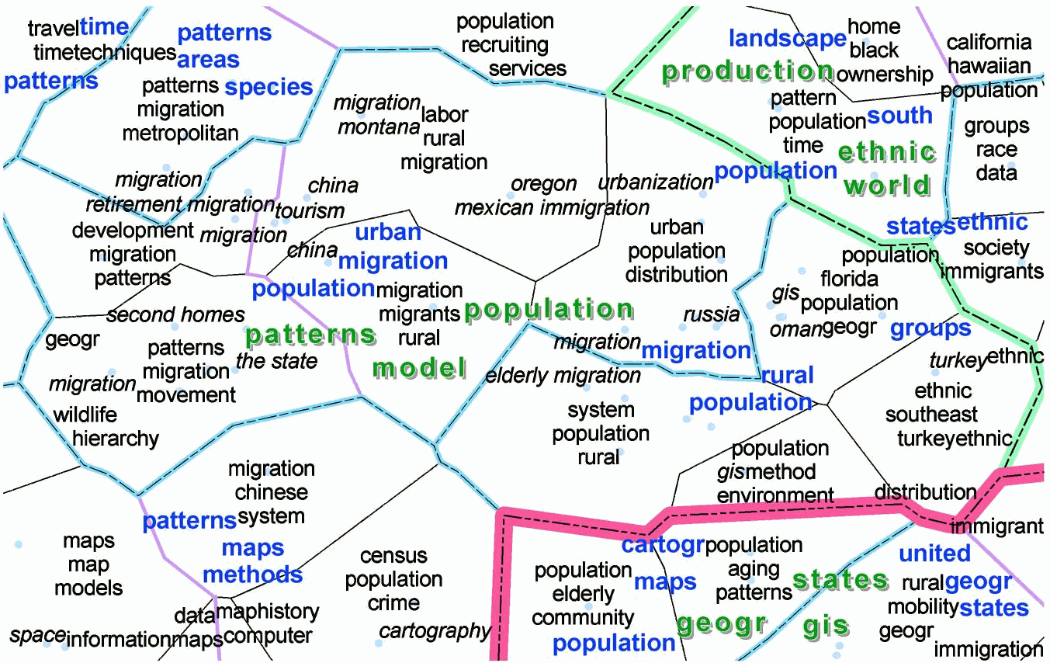
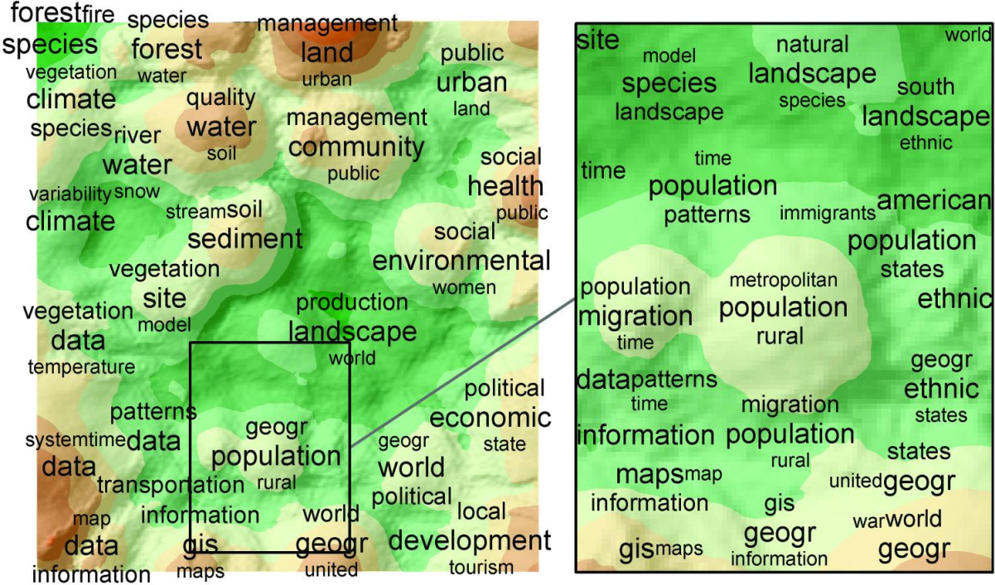
Examples of spatializations obtained with SOM
André Skupin.
The world of geography: visualizing a knowledge domain with cartographic means.
Proceedings of the National Academy of Sciences of the USA, 2004; 101 (Suppl 1): 5274-5278. doi:10.1073/pnas.0307654100.
Based on the number of items associated with each neuron, the result can be treated as a density distribution. SOM output also allows to reveal discontinuities (zones of high dissimilarity between neighbouring neurons), which can be treated as borders or barriers in space.

Slide 50
Recommended reading
Chapter 4. Spatialization
André Skupin and Sara I. Fabrikant
In: John P. Wilson and A. Stewart Fotheringham (editors)
The Handbook of Geographic Information Science
Wiley Online Library
Published Online: 25 FEB 2008
DOI: 10.1002/9780470690819.ch4

Slide 51
Methods for spatialization based on pairwise distances
Nonmetric multidimensional scaling (MDS); Sammon’s mapping (a.k.a. Sammon’s projection); t-SNE
Input: a dissimilarity matrix (a.k.a. distance matrix) computed using a carefully chosen or designed distance function.
The methods attempt to represent the dissimilarities as distances in a low-dimensional space.
Advantage: applicable not only to vectors of numeric values but to objects of any kind whenever meaningful distances can be defined and calculated.

Slide 52
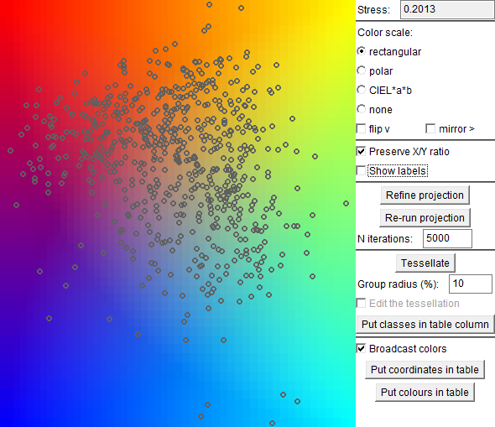
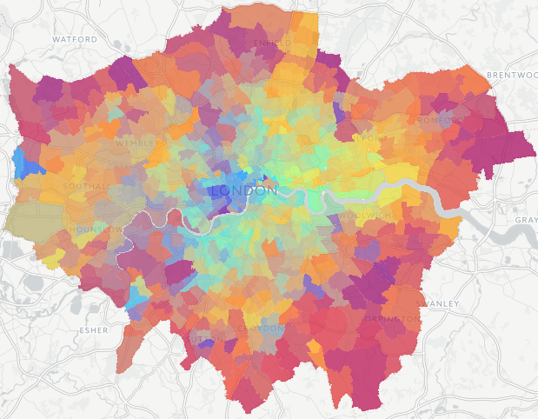
Example: joint distribution of multiple attributes
Artificial space constructed by projection of the attribute value vectors associated with entities (London wards)
Continuous colour variation over the display background
Parallel coordinates plot
Lines represent the same entities as dots in the projection plot and have the corresponding colours from the projection plot background.
The entities (wards) are shown on a map; painted in the corresponding colours from the projection display background.

Slide 53
Beware the distances!
In an ideal projection, the distances between the objects are exactly proportional to the original distances.
However, this condition is typically not achievable. It is not possible to transform data from larger to smaller number of dimensions without distortion of the original distances.
Projection algorithms attempt to minimise the distortions. For a given dataset, different algorithms can be more or less successful.
Measure of distance distortion: projection stress, e.g.
Implication: treat distances in a projection as approximate; look for general patterns and outliers but avoid comparing distances.
high!

Slide 54

Projection interpretation problem
In this projection, informative labels support interpretation, but this requires good understanding of what the labels stand for.
In this projection, labels, such as names of entities, would not be helpful. To understand the meaning of the projection, a user needs to associate different positions in it to the corresponding properties.

Slide 55
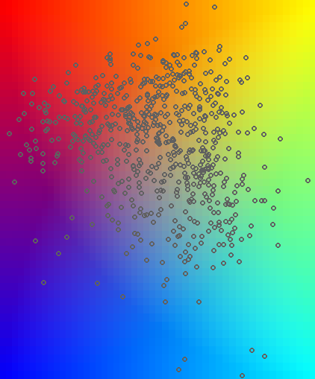
Linking projection positions to properties
The combinations of attribute values that were used for creating the projection are represented by lines on a parallel coordinates plot.
high proportions of children
high proportions of elderly and low proportions of mid-aged
colour propagation
high proportions of mid-aged and low proportions of children

Slide 56
Spatialization for studying dynamic processes
Time-variant data of any type: multidimensional vectors (values of multiple attributes), graphs, evolving texts (e.g., in Wikipedia), images (e.g., satellite images), video, spatial situations, …
The data is a chronological sequence of states
Each state is a single vector, graph, video, text, image, frame in video, situation, …
Spatialization is applied to the set of states
Suitable method and distance function or data representation need to be chosen
The states are represented as points in a space
The points are connected by a polygonal line or curve according to their temporal ordering.

Slide 57
Representative papers
Time Curves: Folding Time to Visualize Patterns of Temporal Evolution in Data
Benjamin Bach, Conglei Shi, Nicolas Heulot, Tara Madhyastha, Tom Grabowski, Pierre Dragicevic
IEEE Transactions on Visualization and Computer Graphics, 22(1):559-568, 2016
Reducing Snapshots to Points: A Visual Analytics Approach to Dynamic Network Exploration
Stef van den Elzen, Danny Holten, Jorik Blaas, Jarke J. van Wijk
IEEE Transactions on Visualization and Computer Graphics, 22(1):1-10, 2016

Slide 58
Example: editing of the Wikipedia article “Chocolate”. The curve shows an edit war in stage 2. Blue halos indicate identical revisions.
Example: a surveillance video of a street. Outliers correspond to passing pedestrians.
Example: precipitation in the US across one year.

Slide 59
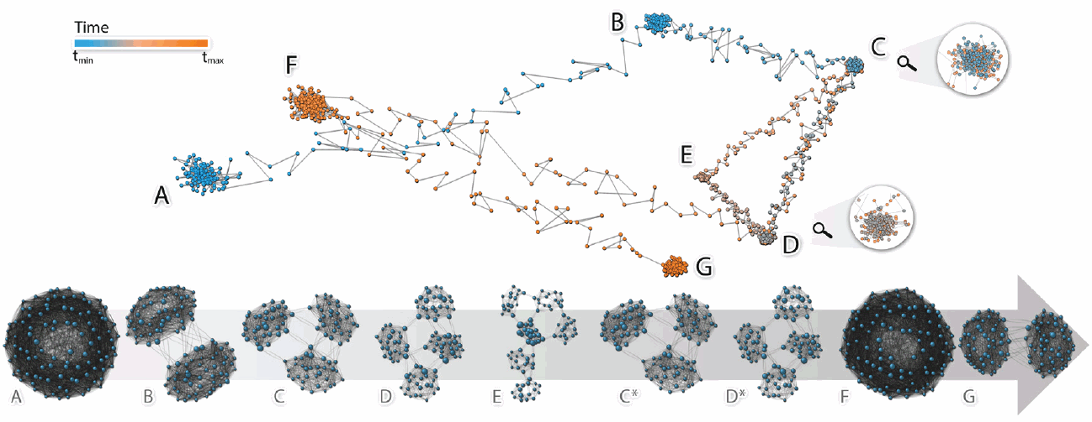
Cluster: no significant changes (stagnation).
Transitions: curve segments between clusters with a high degree of progression.
The presence of multiple clusters and transitions may correspond to a dynamic process with different states.
Cycle: returning to one of previous states after a sequence of changes.
U-turn: reversal in a process.
example

Slide 60
Main takeaways from the lecture
The process of non-trivial data analysis and problem solving essentially involves human reasoning.
The general goal of analysis is to understand a certain subject, which requires understanding relationships between components of the subject.
Understanding requires abstraction from correspondences between particular elements of the components (specified in data) to overall relationships between the components as wholes.
Abstraction is facilitated by visual displays enabling joint perception of multiple correspondences as patterns.
Possible types of patterns depend on the inherent properties of the components, particularly, ordering and distances between their elements.

Slide 61
Main takeaways from the lecture (continued)
Many visualization techniques create arrangements of visual marks (e.g., dots) in a display space.
Such arrangements are perceived as spatial distributions. Humans intuitively identify spatial patterns in such distributions.
Spatial patterns are meaningful when the distances between the item positions in the display space are meaningful, particularly, when the distances represent differences between the items.
A general approach to analysing complex data is spatialization: construction of artificial spaces where distances represent differences.

Slide 62
Additional analysis example: studying population structures in London wards

Slide 63
Data
Data:
Ethnic structure: proportions (%) of different ethnic groups
Structure by social status: proportions (%) of people having different social statuses
Structure by qualification: proportions (%) of people with different qualification levels
Questions:
What is the population composition of different wards? - joint distribution of proportions of different population subgroups
How are the ethnic, social status, and qualification structure interrelated?

Slide 64
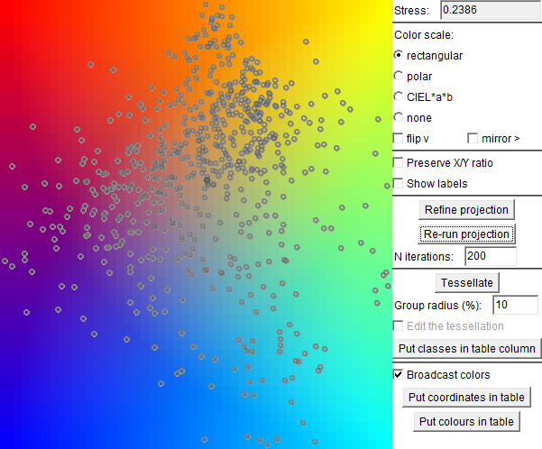
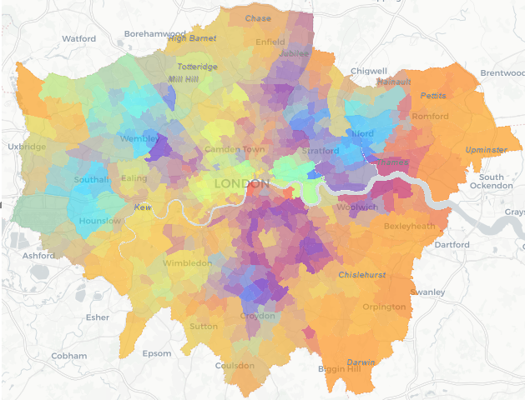
Ethnic structure

Slide 65
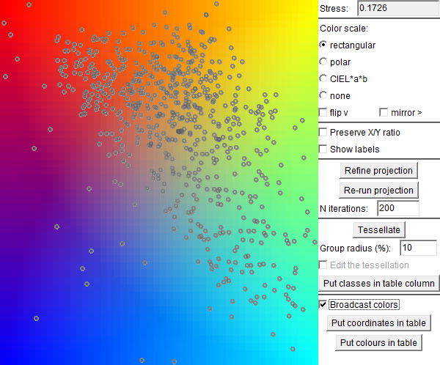
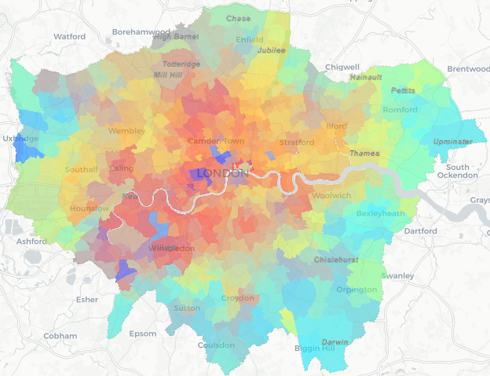
Structure by qualification

Slide 66
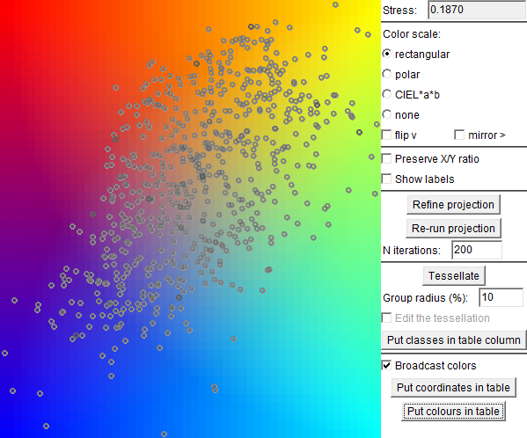
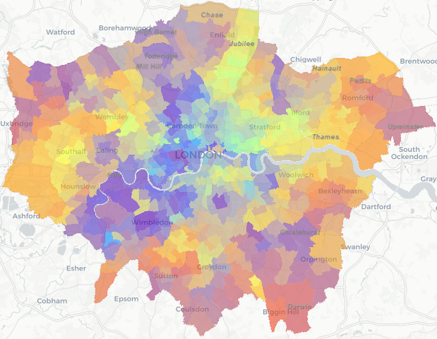
Structure by social status

Slide 67
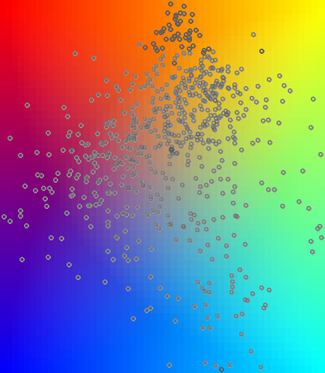
Understanding the ethnic structures
high black and white + black
high white, low others
high white and white + Asian
more black African
high Chinese
more black Caribbean
high Bangladeshi
high Indian, low white
high Pakistani, low white

Slide 68
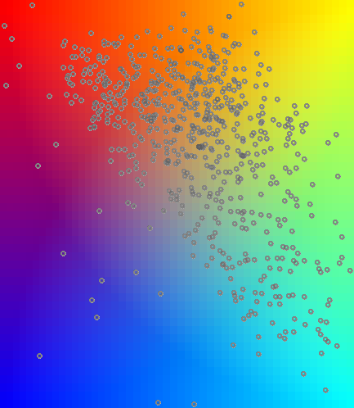
Understanding the qualification structure
high: level 4 low: others
high: no qualification low: others
High: level 3
high: levels 2&3 and apprenticeship

Slide 69
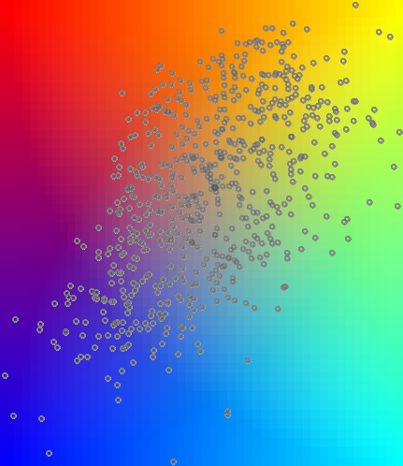
Understanding the social status structure
high: C2
high: DE
high: AB
high: C1

Slide 70
Exploring interrelations: qualification
qualification
ethnic structure
social status
Colours from one projection are propagated to other projections, where background colouring has been turned off. We see that similarly coloured points tend to have close positions in these other projections. This indicates that the groups of attributes corresponding to these positions are interrelated.

Slide 71
qualification
social status
ethnic structure

Slide 72

Exploring interrelations: social status
qualification
ethnic structure
social status
Again, we see an indication of quite high interrelatedness.

Slide 73
social status
qualification
ethnic structure

Slide 74
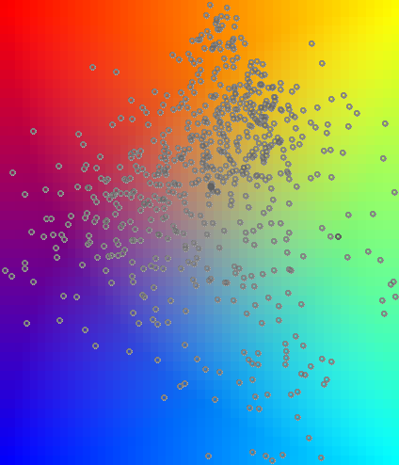
Exploring interrelations: ethnic structure
qualification
ethnic structure
social status
We see a higher mixture of colours in the qualification projection than in the social status projection, which means that there is higher interrelation between the ethnic structure and the social status than between the ethnic structure and the qualification level.

Slide 75
ethnic structure
social status
qualification
coloured
coloured
white
white
white
white
white
white
coloured
coloured

Slide 76
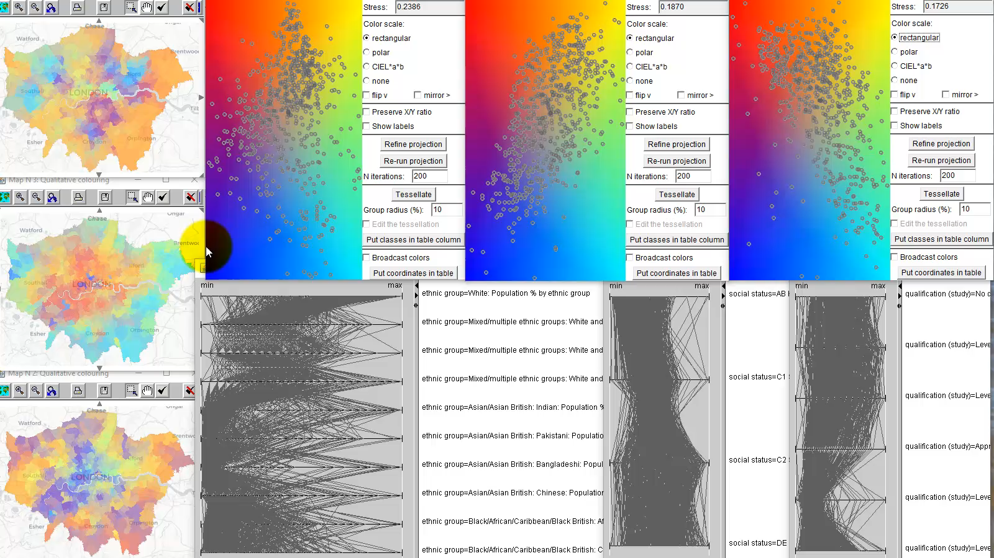
Interactive operations for linking multiple displays

Slide 77
Findings
White
Mixed: white + Asian
Asian: Chinese
Asian: Indian
Asian: Pakistani
Asian: Bangladeshi
Black: Caribbean
Black: African
Mixed: white + black
Level 4 (high)
Level 3
Apprenticeship
Level 2
Level 1
No qualification
AB: high and intermediate managerial
C1: supervisory, clerical, junior managerial
C2: skilled manual
DE: semi-skilled and unskilled manual
Level 4 (high)
Level 3
Apprenticeship
Level 2
Level 1
No qualification

Slide 78
Conclusion
Projection is a convenient tool for studying joint distributions of multiple numeric attributes and interrelations between groups of numeric attributes.
Projections creates an artificial space, in which objects characterised by the attributes receive relative positions according to similarities between the respective combinations of the attribute values.
In a projection, we look for general spatial patterns (shapes) and outliers but do not assess and compare the distances; they may be distorted.
To interpret a projection (i.e., what different positions mean), we need additional displays linked to the projection through colour propagation, highlighting, or filtering.
Some way of linking (particularly, between two or more projection displays) is also necessary for studying interrelations.

